Slide 1
Leap Walking
Gesture-Based Walking
Corinna List | Daniela Neupert | Interaction Engineering | WS 17/18 | Prof. Dr. Michael Kipp

Slide 2
Motivation
Can walking with fingers be mapped to a game character?
„Kinect“ for disabled people
Notes:
We wanted to use a leap motion
We asked ourselves: How can we map the Hand to a Character -> index and middlefinger are similar to the legs
Could be a possibility for the disabled to experience a „kinect“

Slide 3
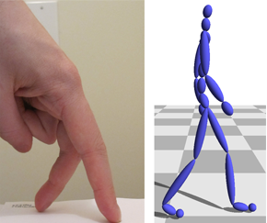
Related Work
Noah Lockwood, Karan Singh (2012): Motion Editing with Contact Based Hand Performance
They used Finger-Walking to animate a character
Notes:
Diffrences:
We use Leap-Motion instead of a Tabletop-Display
they only receive finger tips data
We control a game and do not create animations

Slide 4
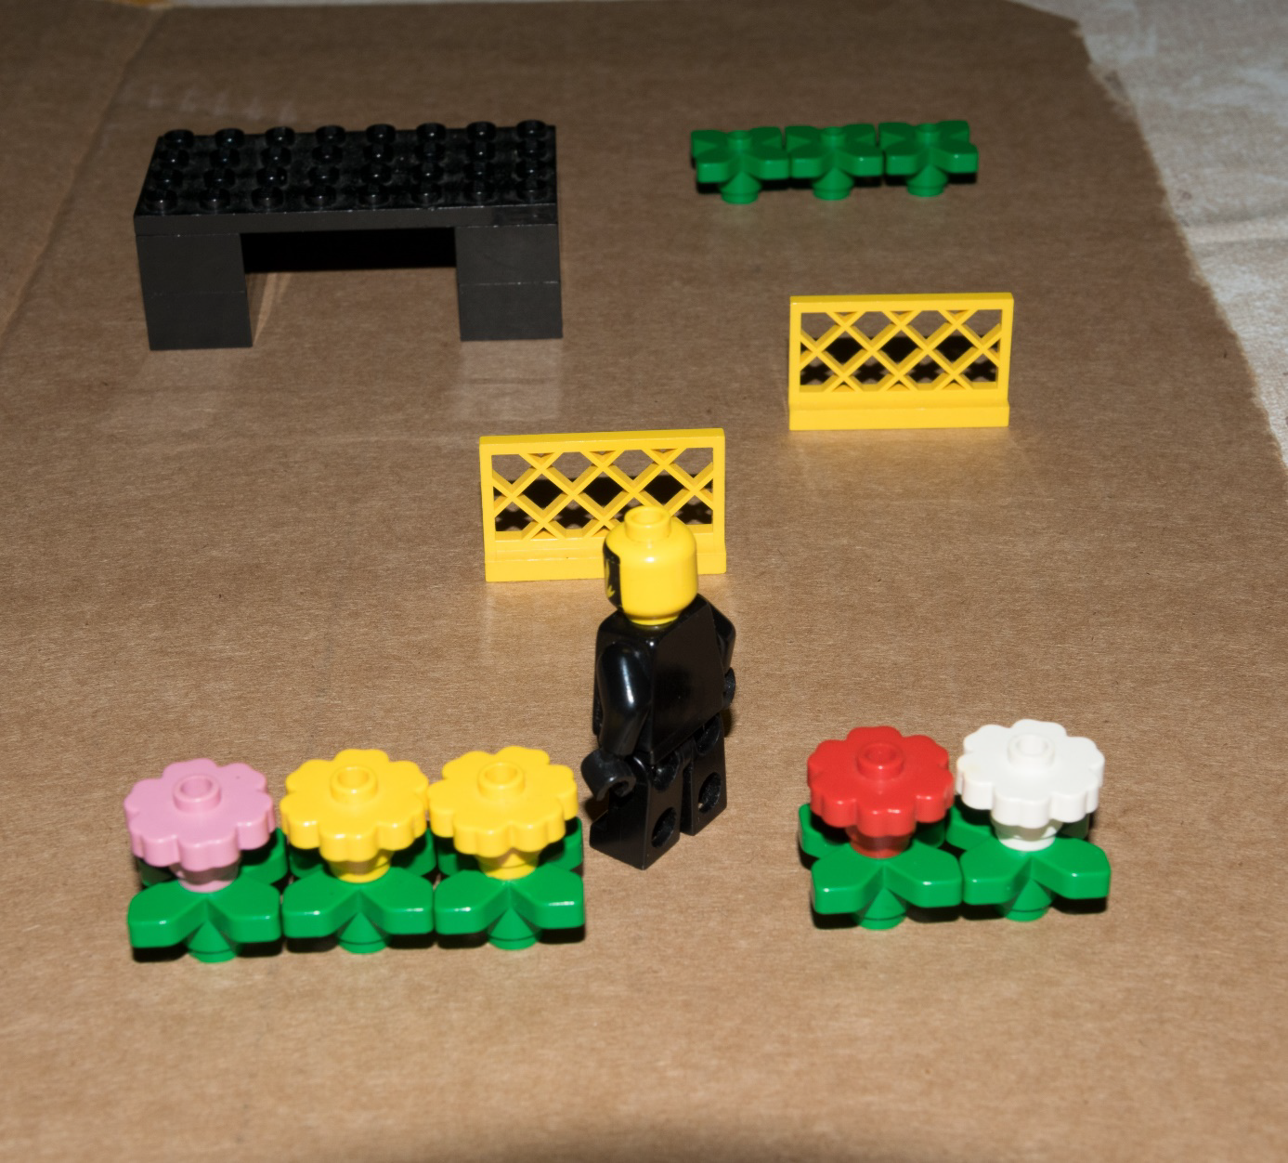
Concept
Map the walking-gesture to the movement of a character
Develop a jump‘n‘run-game to test the approach
Notes:
To test the approach we thought it would be best to develop a game, where the user has to reach the end of a parcour
To achieve this, he has to avoid obstacles, which are high or low

Slide 5
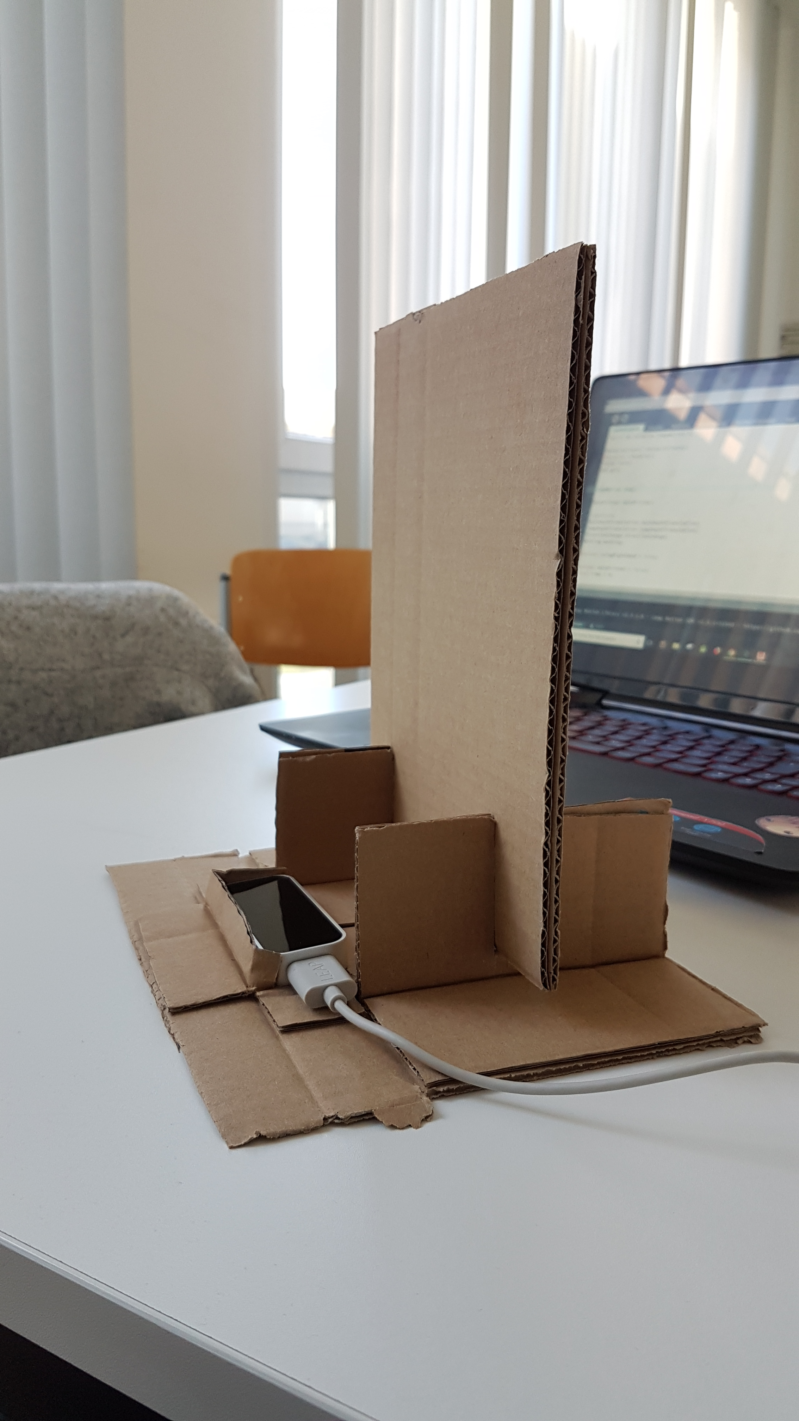
Setup
LeapMotion tracks best horizontally
Creating a Frame for the users orientation
Notes:
- First thought: walking on the table -> leap in front of the user‘s chest

Slide 6
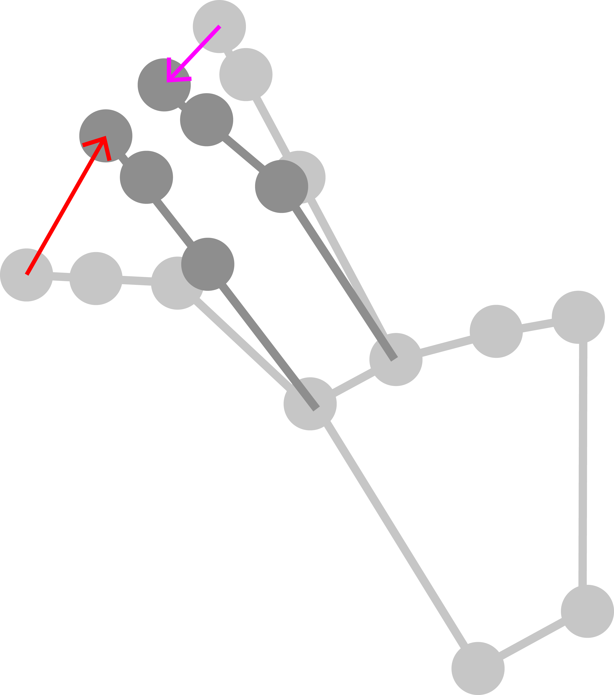
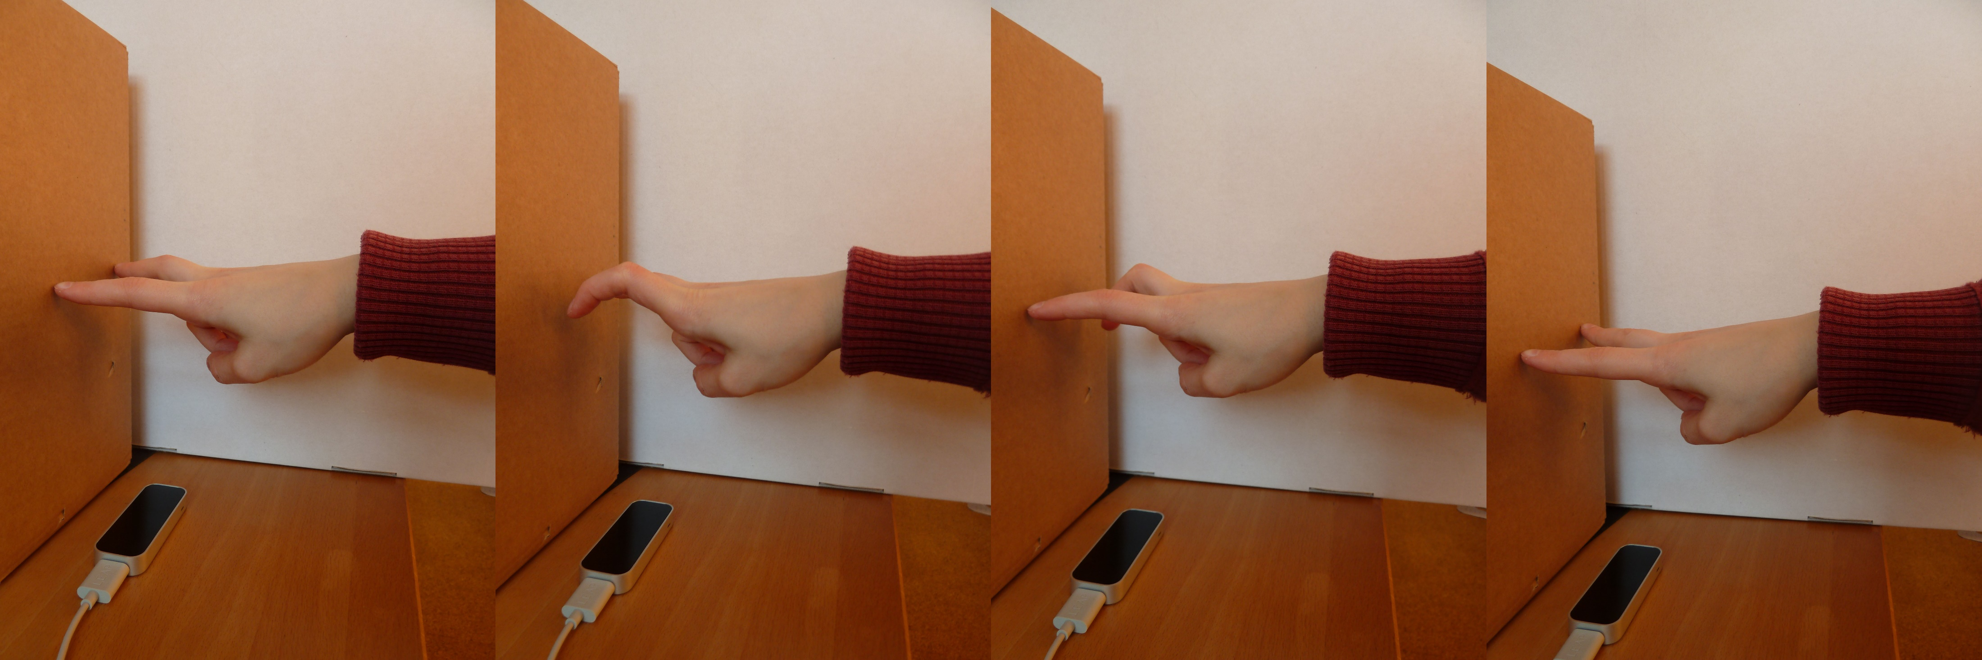
Interaction Techniques
Walking
Notes:
To walk, the user has to lift up one of the “legs” (index or middle finger) vertically, while the other one moves down
1. Calculate vector between old and current position of index and middle finger
2. Calculate angle between those two
3. angle > 90° and angle < 180° -> opposite vectors -> walking
4. Calculate speed: frequence of changes of the direction of the index finger movement

Slide 7
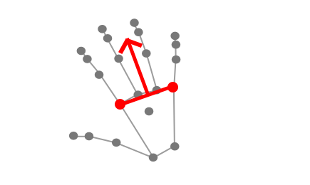
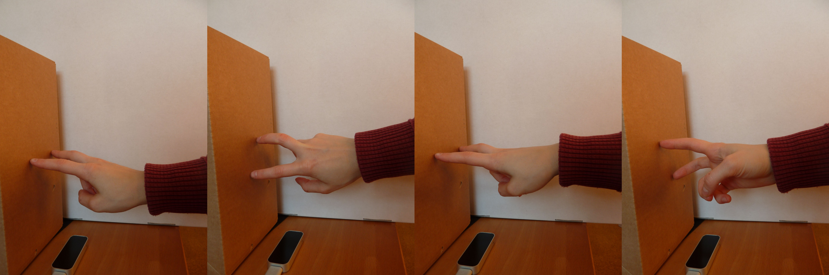
Interaction Techniques
Walking Curves
Notes:
We track the distance of the index finger and the pinky finger-knuckle
The user walks to the direction that the perpendicular (orthogonal) vector is facing

Slide 8
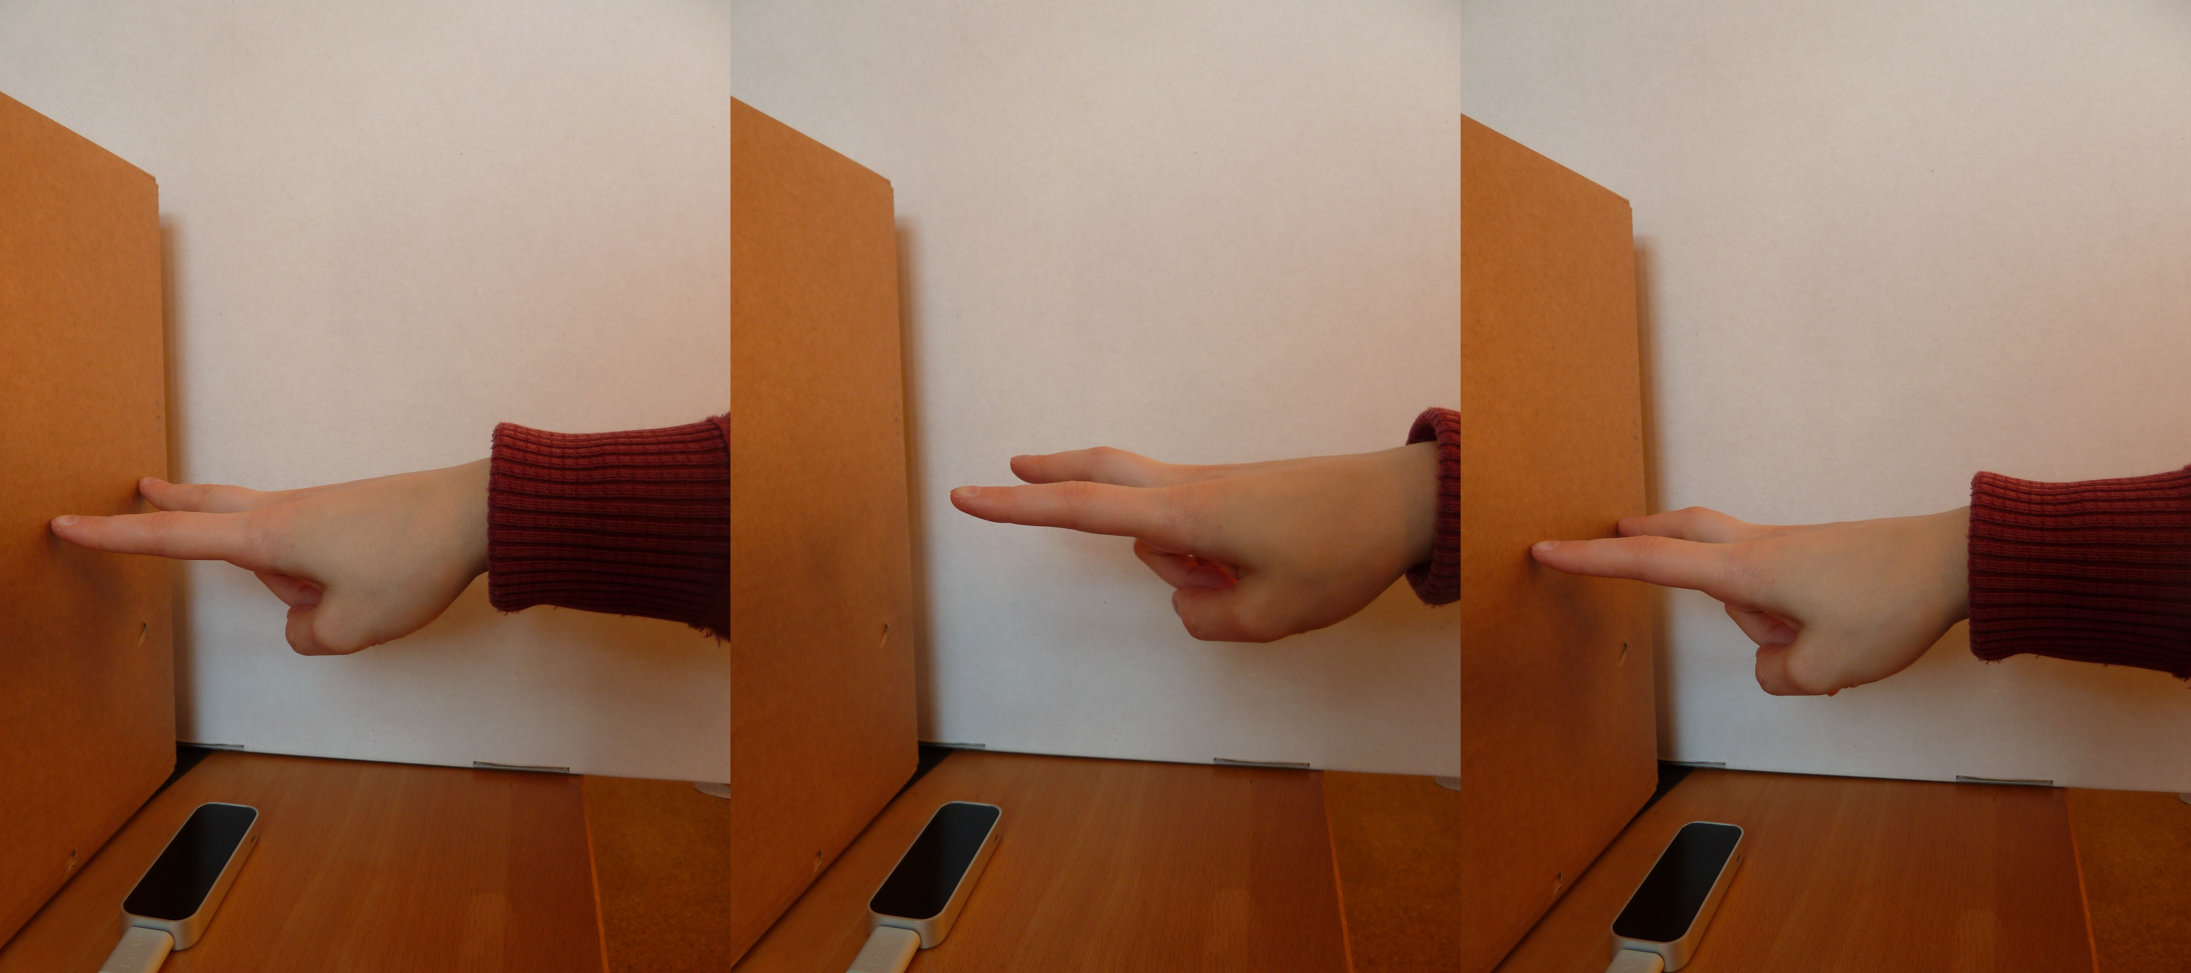
Interaction Techniques
Jumping
Notes:
For jumping, both, the tip of the index and the tip of the middlefinger have to be away from their initial position
auto movement starts (automatic jump for a certain time to a certain distance)

Slide 9
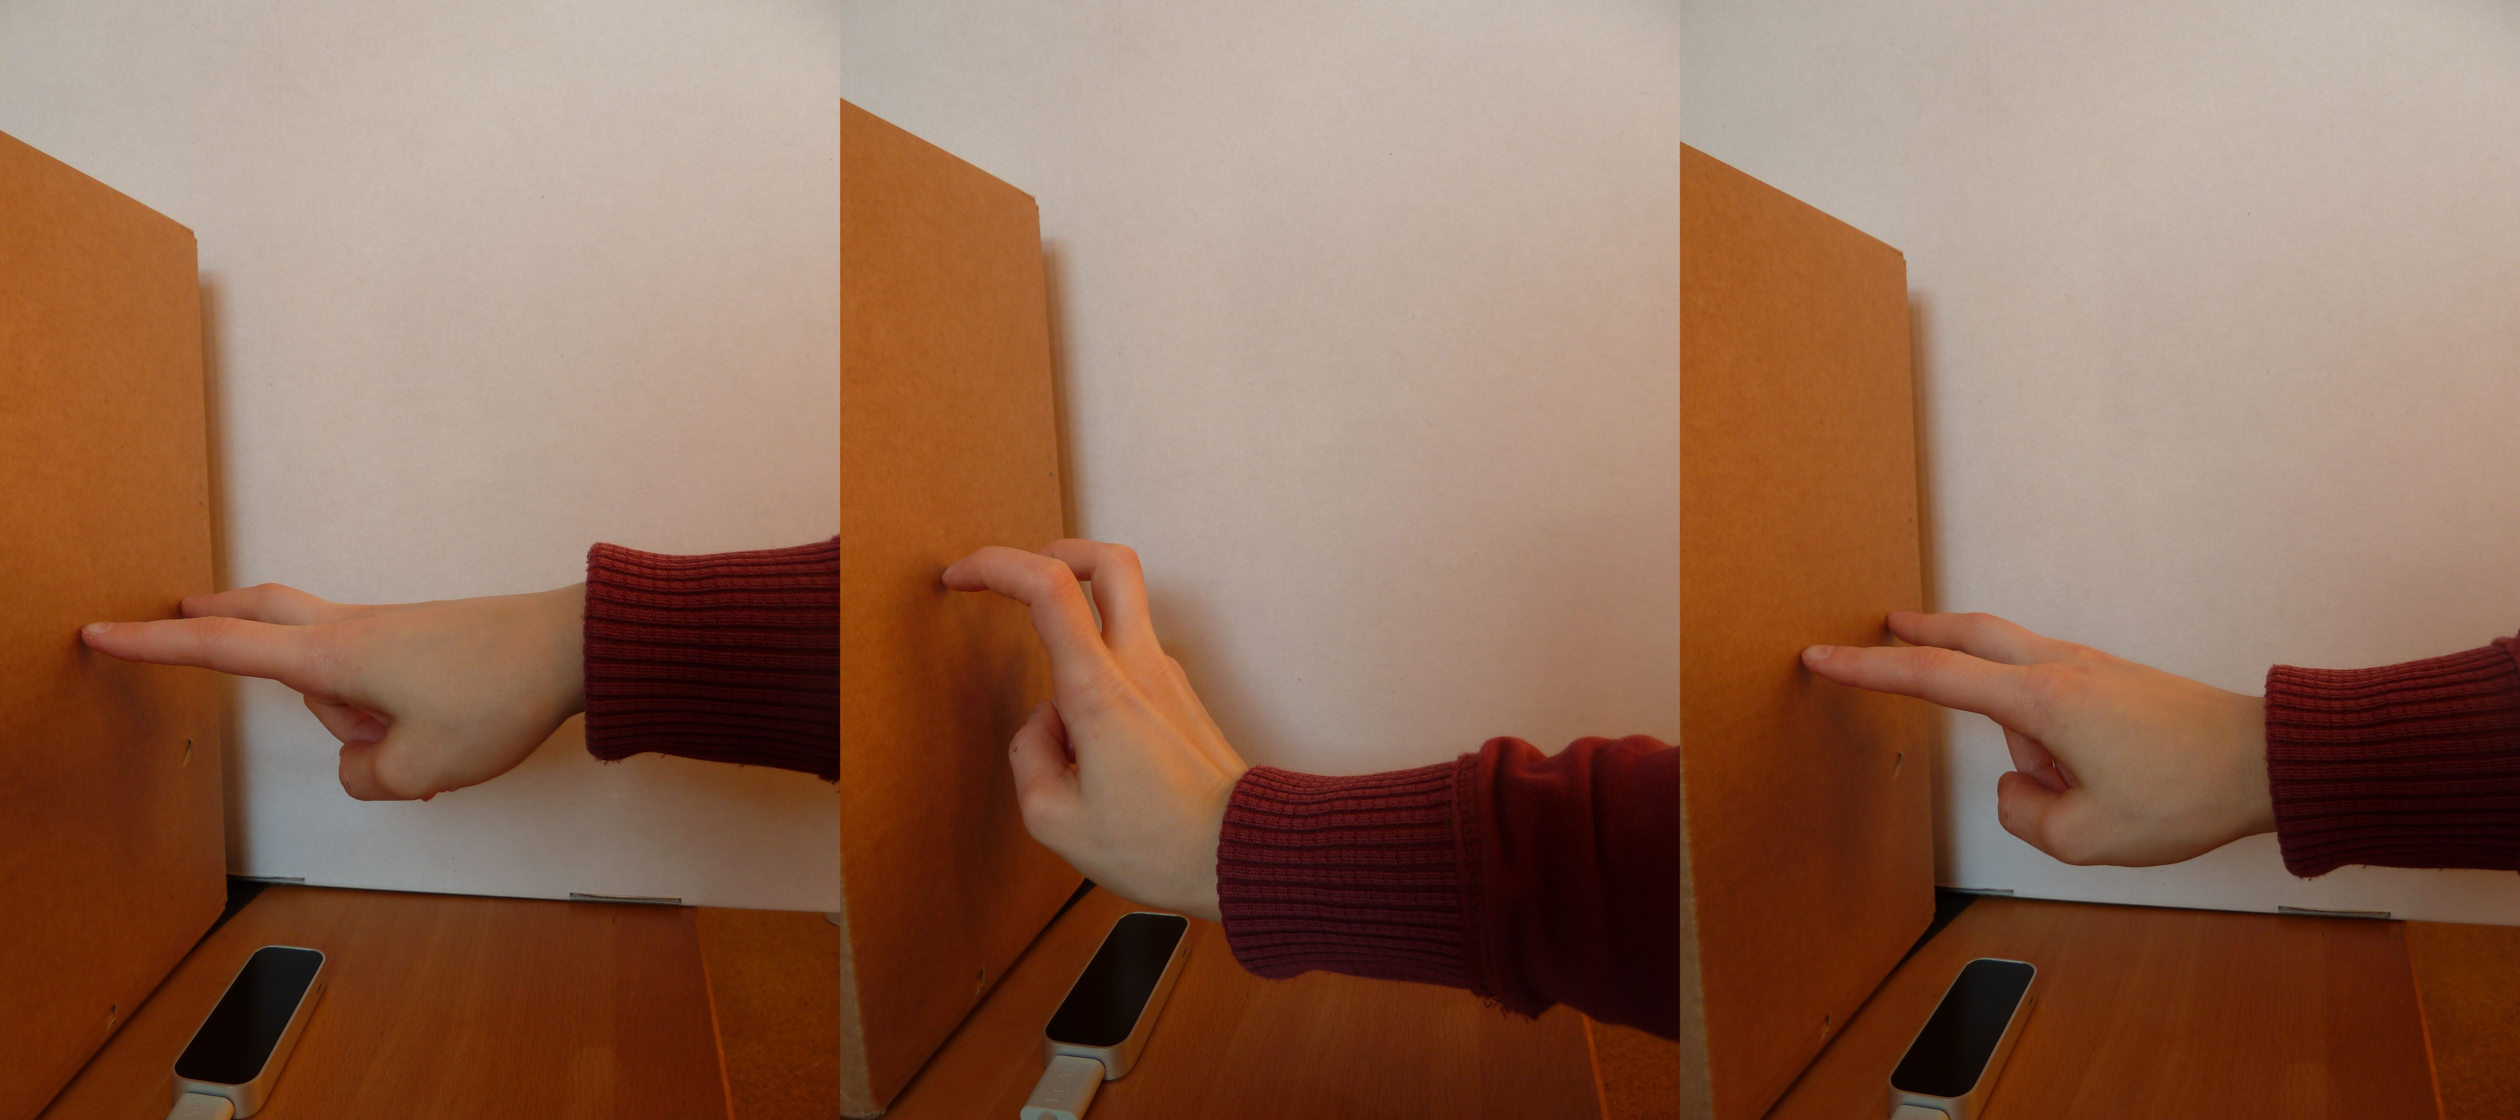
Interaction Techniques
Ducking
Notes:
Ducking is detected by watching the movement of the wrist
If its next to the cardboard, the user ducks
auto movement starts (automatic duck for a certain time to a certain distance)

Slide 10
Technical Realization
Leap Motion
Processing (LeapMotionForProcessing by Darius Morawiec)
Frame for the LeapMotion

Slide 11
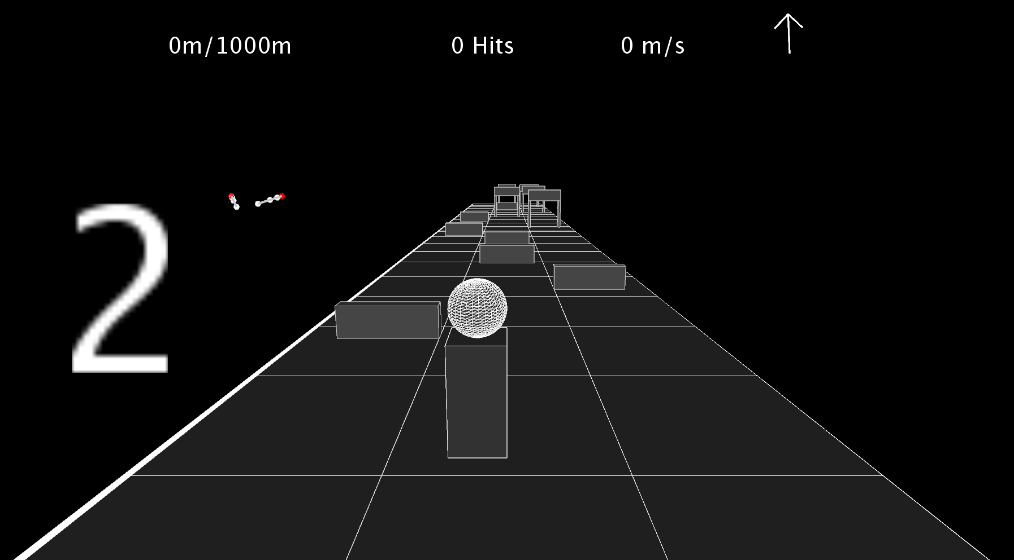
Demonstration
Notes:
Explain briefly the GUI:
Timer that shows the start time
walked distance/total distance
hits counter
walking speed
walking direction
position of index and middle finger
2. Explain briefly the game setup:
two kinds of obstacles (user has to duck, jump or just walk around)
End reached after certain distance
3. Show the different gestures
4. Show end screen

Slide 12
Evaluation
Difficult distinction between walking and non-walking gesture
Walking is tiring for the hand
Notes:
Minor inaccurate movements of the hand may give wrong results and lead to non-walking value -> „repairing“ this issue lead to a „slide“ after the character should already have stopped

Slide 13
Future Work
Are there other possibilities to map the hand to the body?
Which other gestures can be used?
Could the hand positioning be different?
Thanks for your attention!
Notes:
Hand positioning: e.g. rest on the arrmrest of the chair (LeapMotion positioned on the chairs armrest?)

